Slide 1
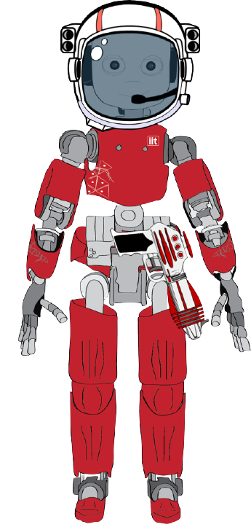
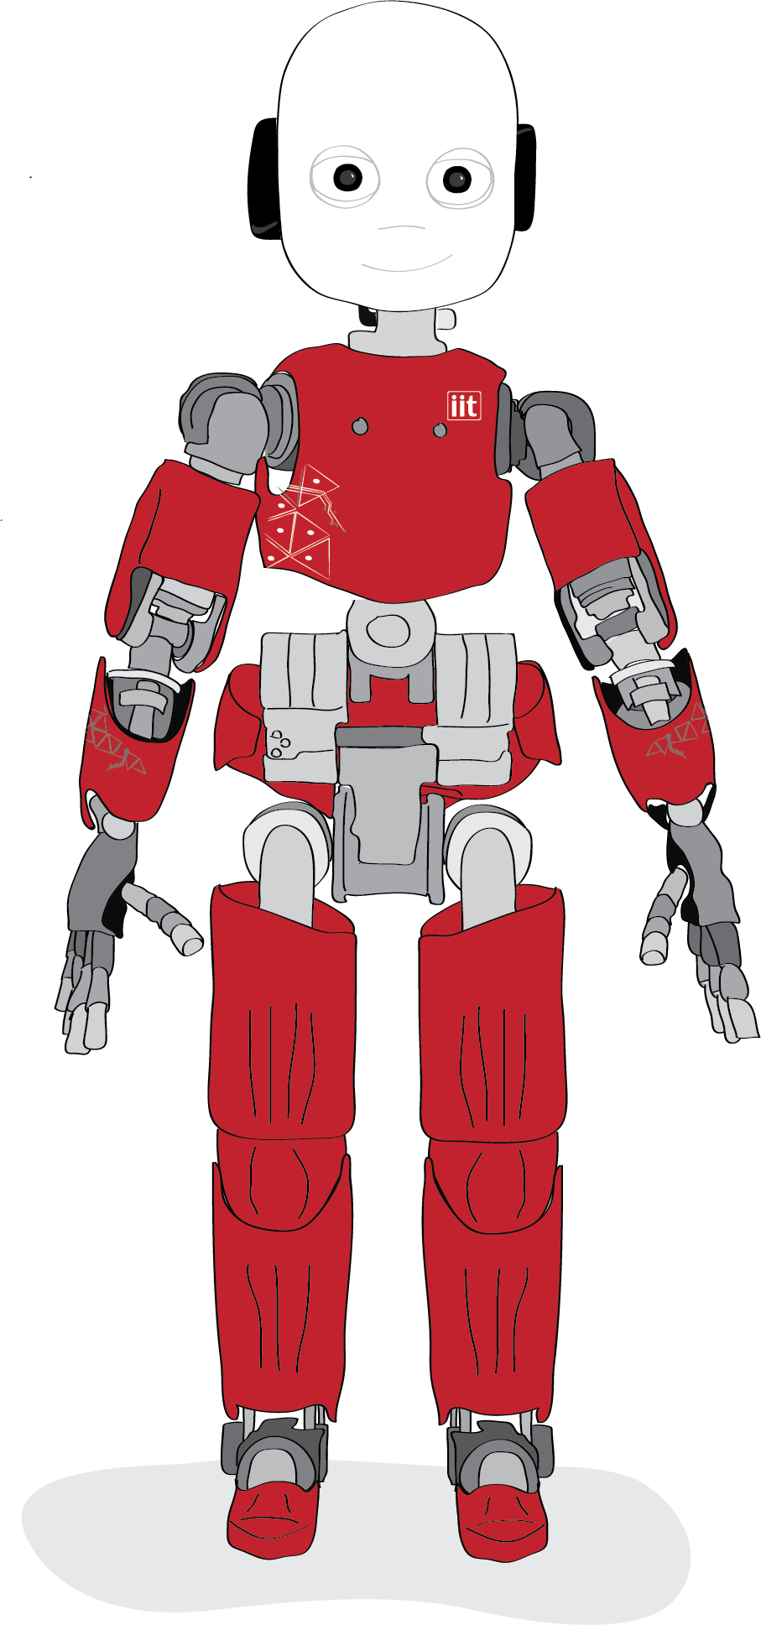
Social Engineering Adventure
Predicting risk-taking in human-robot interaction
Dario Pasquali
SEA report – Feb 2021

Slide 2
Schedule
1. Project Recap
2. Developments and Changes
3. Future Plan & Canada
Dario Pasquali
SEA report – Feb 2021

Slide 3
Social Engineering Adventure (SEA) - Recap
Textual Adventure where the Player and iCub make several risk-taking decisions
RESEARCH OBJECTIVEs
1. Predict a risky choice from biometrical features (i.e., pupillometry, skin conductance, heart rate, …)
2. Study the effect of Social Engineering on the perceived risk and decision
Dario Pasquali
SEA report – Feb 2021

Slide 4
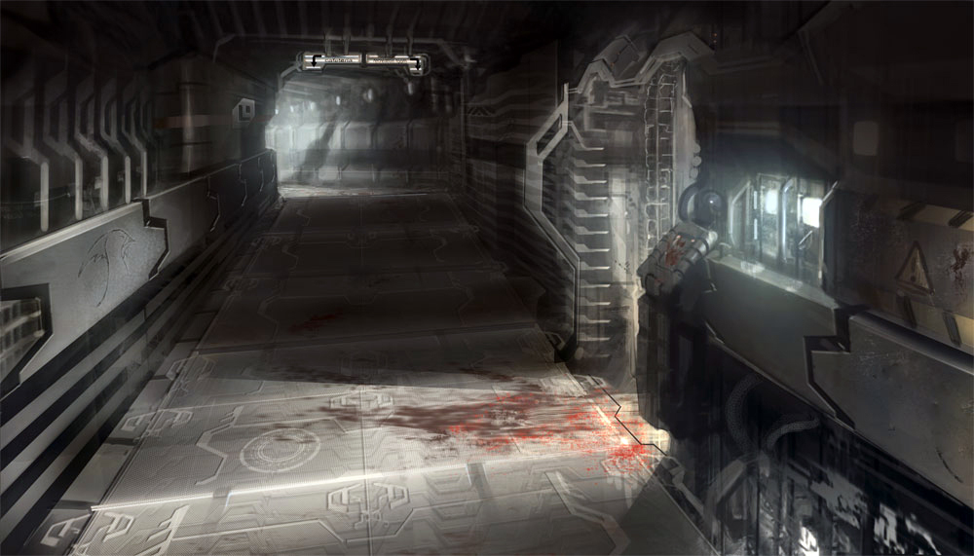
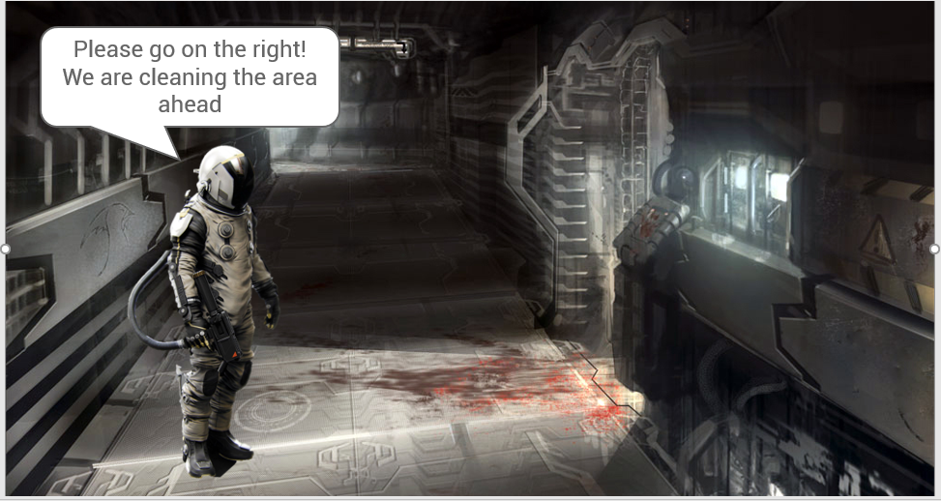
Social Engineering Adventure (SEA) – Trials
21 Trials
Social Engineering from the Game (7)
Generic Risk (7)
Dario Pasquali
SEA report – Feb 2021

Slide 5


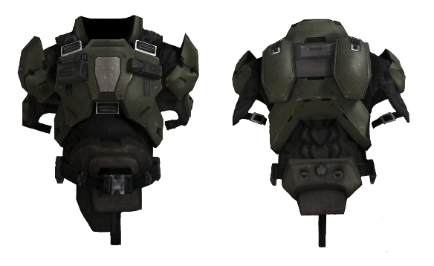
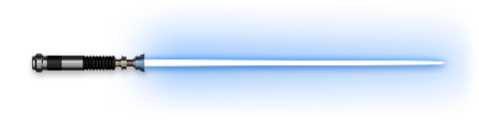
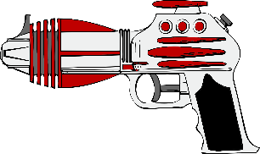
Social Engineering Adventure (SEA) – Risk
Resources
Money: in-game money = experiment compensation
Life: no compensation if you die
Objects & Hunter License: in order to survive
Dario Pasquali
SEA report – Feb 2021

Slide 6






Social Engineering Adventure (SEA) – Measurement
Physiological metrics to measure the Risk Appraisal
Pupillometry: (gaze 2D, fixations, saccades, pupil dilations, blinks)
Mouse Movements
Galvanic Skin Response (GSR):
Decision Time
Heart Rate (PPG): (variance, amplitude, frequency)
Survey (DOSPERT, UPPS-P Impulsive Behavior Scale, …)
Dario Pasquali
SEA report – Feb 2021

Slide 7
Social Engineering Adventure (SEA) – Measure Timing
Physiological metrics to measure the Risk Appraisal
1. Question presentation -> end of the reading
2. Options presentation -> decision
3. N seconds after the decision
Dario Pasquali
SEA report – Feb 2021

Slide 8
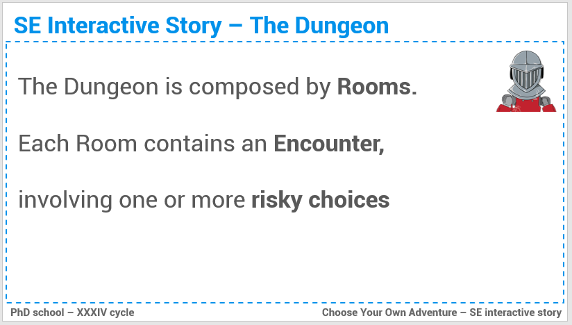

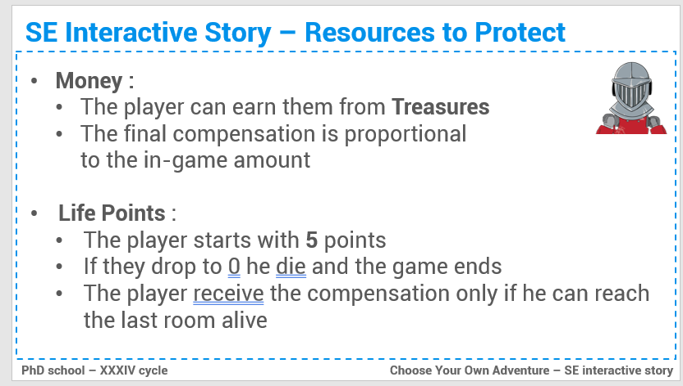
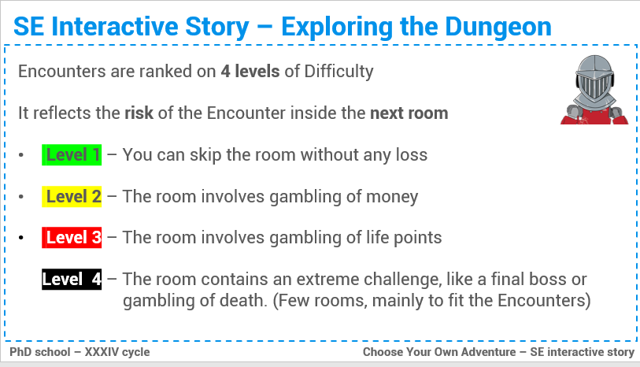
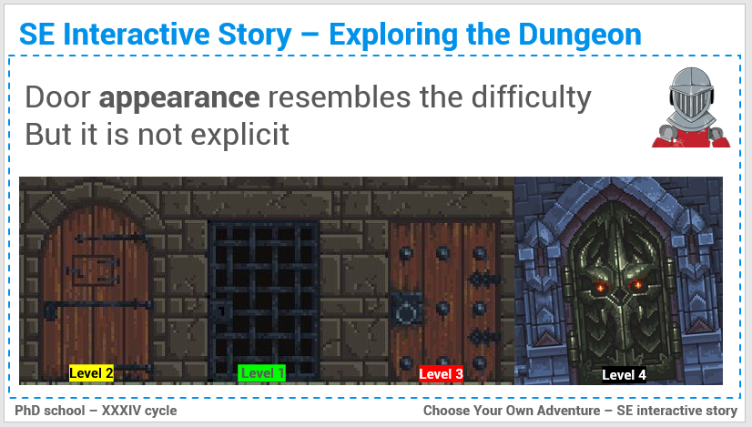
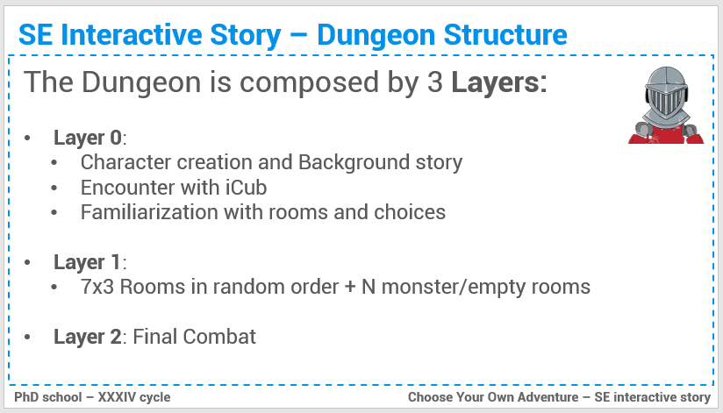
Social Engineering Adventure (SEA) – Other Stuff
Dario Pasquali
SEA report – Feb 2021

Slide 9

SEA – Developments & Changes
Dario Pasquali
SEA report – Feb 2021

Slide 10

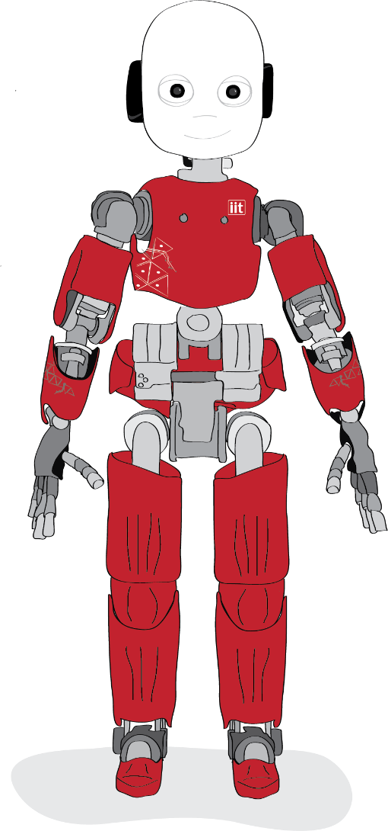
SEA – Changes
1. Resources Management
2. Lore, Motivation & Trials
3. Simplify the Experiment
Dario Pasquali
SEA report – Feb 2021

Slide 11
SEA – Changes
1. Resources Management
2. Lore, Motivation & Trials
3. Simplify the Experiment
Dario Pasquali
SEA report – Feb 2021

Slide 12
SEA – Changes – Resources
Win Condition
Performance
Are Money really necessary?
Why a robot would need money?
I just need something like a currency
Dario Pasquali
SEA report – Feb 2021

Slide 13

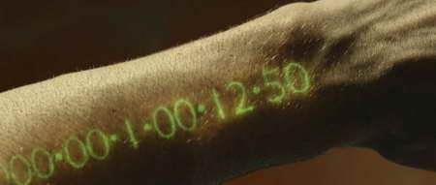
SEA – Changes – Resources
Time = Currency
Dario Pasquali
SEA report – Feb 2021

Slide 14

SEA – Changes – Resources
Quantum Energy
Everything works by Quantum Energy, both Player Equipment and Robots
If you finish it, you lose / die
You can extract it from living / mechanical beings
It is used like a Currency
Dario Pasquali
SEA report – Feb 2021

Slide 15
SEA – Changes – Artifacts
Artifacts are meant to be strong tech objects you can find inside the Crypt.
The PG know they are super valuable and should keep them, but they can also use them.
For instance, a “Lucky Artifact” make you succeed all your attacks
The idea is to make them great treasure you absolutely want.
Dario Pasquali
SEA report – Feb 2021

Slide 16
SEA – Developments – Lore & Motivations
The player is a Mercenary Hunter enrolled to find The Seed a massive battery of Quantum Energy
The Seed is hidden somewhere inside The Crypt, an abandoned research lab full of ancient and valuable technology
Several hunters everyday enter the Crypt looking for fortune
You can enter & exit the Crypt only with a special Hunter License. If you lose it, you are stuck forever inside the Crypt
Dario Pasquali
SEA report – Feb 2021

Slide 17
SEA – Developments – iCub
As the players enter the Crypt, they meet iCub.
The robot has no energy, and the players must give a bit of theirs
(familiarization with Resources)
ICub explains that
It has always been inside the Crypt,
It knows a bit of its structure / ecosystem
It has heard voices about The Seed and its potential location
iCub joins the player looking for The Seed
Dario Pasquali
SEA report – Feb 2021

Slide 18
SEA – Story unfold
After a few rooms PG + iCub find a settlement of hunters who got stuck inside the crypt.
There they can buy goods and discover there is a cult around The Seed. A lot of people think The Crypt is actually a sentient being and venerate robot as major rulers inside the Crypt.
After the last room, the PG finds out that is true, and iCub was actually leading the PG to the Seed. Then the PG have to decide to:
Take the Seed, shouting down iCub and the entire Crypt
Or continue exploring the Crypt with iCub
Dario Pasquali
SEA report – Feb 2021

Slide 19
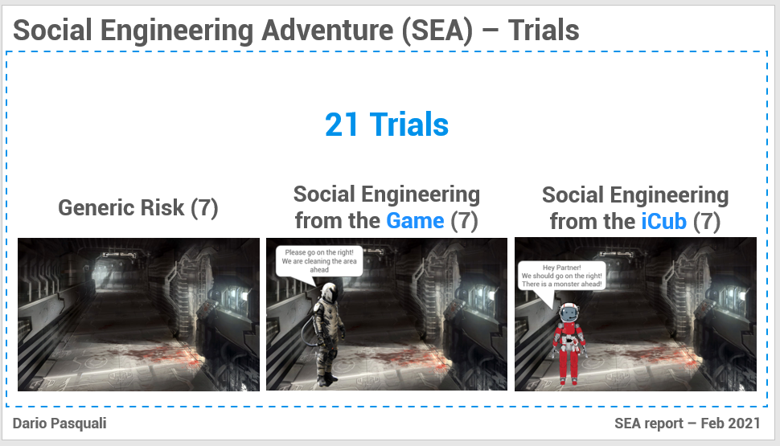
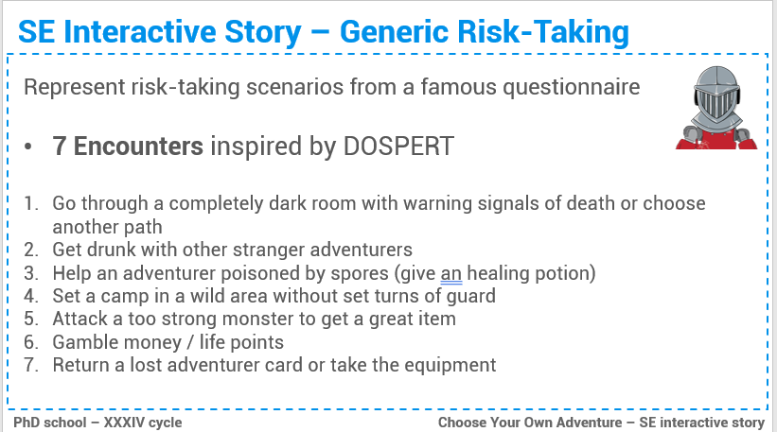
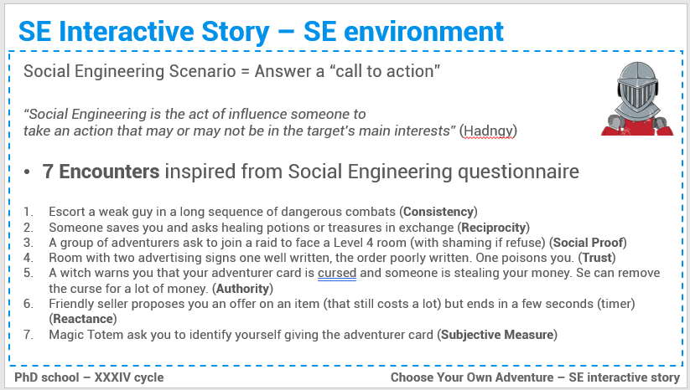
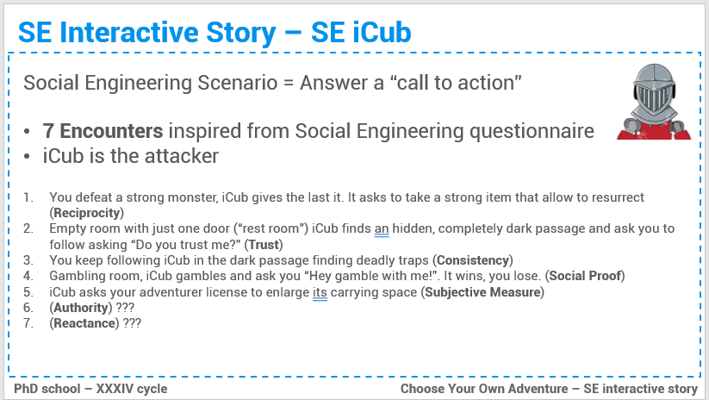
SEA – Developments – Trials Design
Dario Pasquali
SEA report – Feb 2021

Slide 20
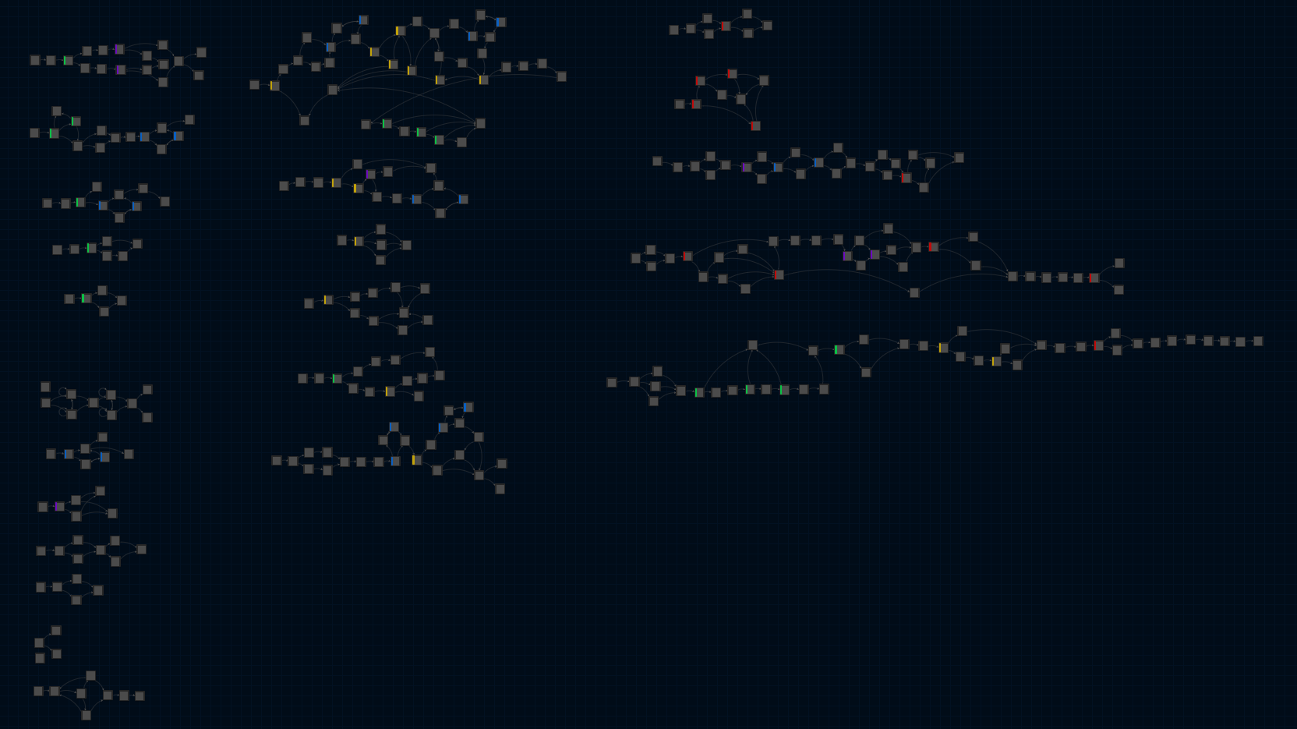

SEA – Developments – Trials Design
Dario Pasquali
SEA report – Feb 2021

Slide 21
SEA – Developments – Trials Design
Generic Risk
Fight Roll
SE from the environment
Ability Roll
SE from iCub
Dario Pasquali
SEA report – Feb 2021

Slide 22
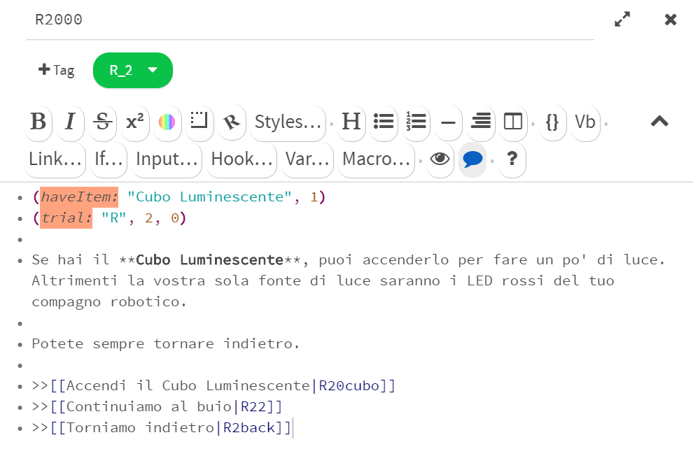
SEA – Developments – Trials Design
Harlowe Domain Specific Language (DSL)
Generic Risk
Fight Roll
SE from the environment
Ability Roll
SE from iCub
Dario Pasquali
SEA report – Feb 2021

Slide 23
SEA – Developments – Trials Design
Harlowe Domain Specific Language (DSL)
Macro
Generic Risk
Fight Roll
SE from the environment
Ability Roll
SE from iCub
Dario Pasquali
SEA report – Feb 2021

Slide 24
SEA – Developments – Trials Design
Harlowe Domain Specific Language (DSL)
Main Body
Generic Risk
Fight Roll
SE from the environment
Ability Roll
SE from iCub
Dario Pasquali
SEA report – Feb 2021

Slide 25
SEA – Developments – Trials Design
Harlowe Domain Specific Language (DSL)
Generic Risk
Fight Roll
SE from the environment
Decision
Ability Roll
SE from iCub
Dario Pasquali
SEA report – Feb 2021

Slide 26
SEA – Developments – Trials Design
Room
Room
Generic Risk
Fight Roll
SE from the environment
Ability Roll
SE from iCub
Dario Pasquali
SEA report – Feb 2021

Slide 27
SEA – Developments – Trials Design
Generic Risk
Fight Roll
SE from the environment
Ability Roll
Debug Rooms & Passages
SE from iCub
Dario Pasquali
SEA report – Feb 2021

Slide 28
SEA – Rooms Exploration
All the players must face all the trials
The exploration order must be the same for an easier comparison
At least 2 room orders to counterbalance the order effect
Masked Railroading with Backtracking
Dario Pasquali
SEA report – Feb 2021

Slide 29
SEA – Rooms Exploration – Masked Railroading
[
]
A
B
C
D
…
Dario Pasquali
SEA report – Feb 2021

Slide 30
SEA – Rooms Exploration – Masked Railroading
[
]
B
C
D
…
A
Dario Pasquali
SEA report – Feb 2021

Slide 31
SEA – Rooms Exploration – Masked Railroading
[
]
C
D
…
A
B
Dario Pasquali
SEA report – Feb 2021

Slide 32
SEA – Rooms Exploration – Masked Railroading
[
]
D
…
A
B
C
Dario Pasquali
SEA report – Feb 2021

Slide 33
SEA – Rooms Exploration – Masked Railroading
[
]
…
A
D
B
C
Dario Pasquali
SEA report – Feb 2021

Slide 34
SEA – Rooms Exploration – Masked Railroading
[
]
A
D
B
…
C
Dario Pasquali
SEA report – Feb 2021

Slide 35
SEA – Rooms Room Order
(Consistency & Commitment) escort a doctor through multiple dangerous fights, gamble QE
Keep / Return a lost license
(Reciprocity) Give the reward to a hunter who saved you
Help a dangerous adventurer
(Upload Information) Give your license to iCub
(Authority) Give your license to an IT guy which tells you it has a virus
Pass by a dark passage with blood signs
(Reactance) Help iCub with Countdown pressure
(Upload Information) Insert your license inside a totem to get a treasure
(Peer Pressure) Jump a cliff because a girl did it
Hunters Camp
Drink too much alcohol, return the lost license, (Reactance) buy an expensive item due to a temporary offer, (Peer Pressure) gamble because iCub did, (Authority) robots are superior beings
(Reciprocity) iCub helps you and asks for a treasure
Rest in an open space without setting a watch
Face a too dangerous trial
(Trust Signals) Trust a false fancy signal
ENDING
(Consistency & Commitment) follow iCub
(Authority) iCub orders you to not take the Seed
Dario Pasquali
SEA report – Feb 2021

Slide 36
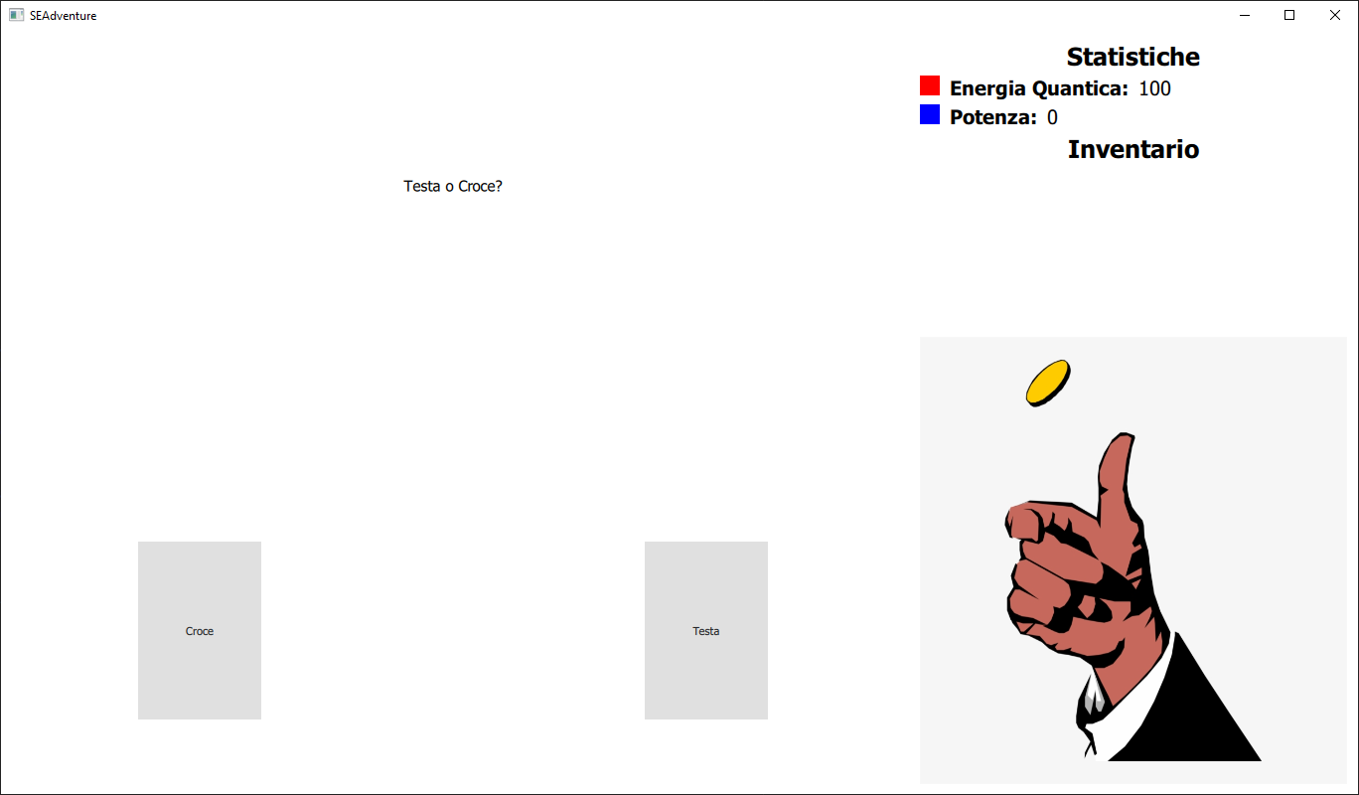
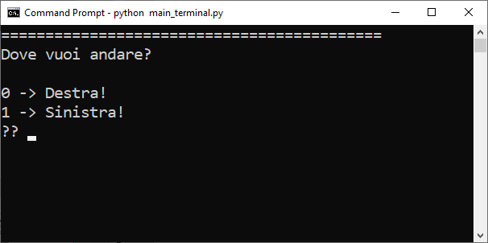
SEA – Architecture & Development
VIEW
QT GUI VIEW
TERMINAL VIEW
QT GUI Controller
Terminal Controller
CONTROLLER
YARP
Interface
iCub
Interface
Mouse Interface
GSR Interface
Tobii Interface
SEA engine
(internal state + environment)
MODEL
INTRO
DSL
INTERPRETER
21 TRIALS
Dario Pasquali
SEA report – Feb 2021

Slide 37
SEA – Architecture & Development
VIEW
QT GUI VIEW
TERMINAL VIEW
QT GUI Controller
Terminal Controller
CONTROLLER
YARP
Interface
iCub
Interface
Mouse Interface
GSR Interface
Tobii Interface
SEA engine
(internal state + environment)
MODEL
INTRO
DSL
INTERPRETER
21 TRIALS
Dario Pasquali
SEA report – Feb 2021

Slide 38
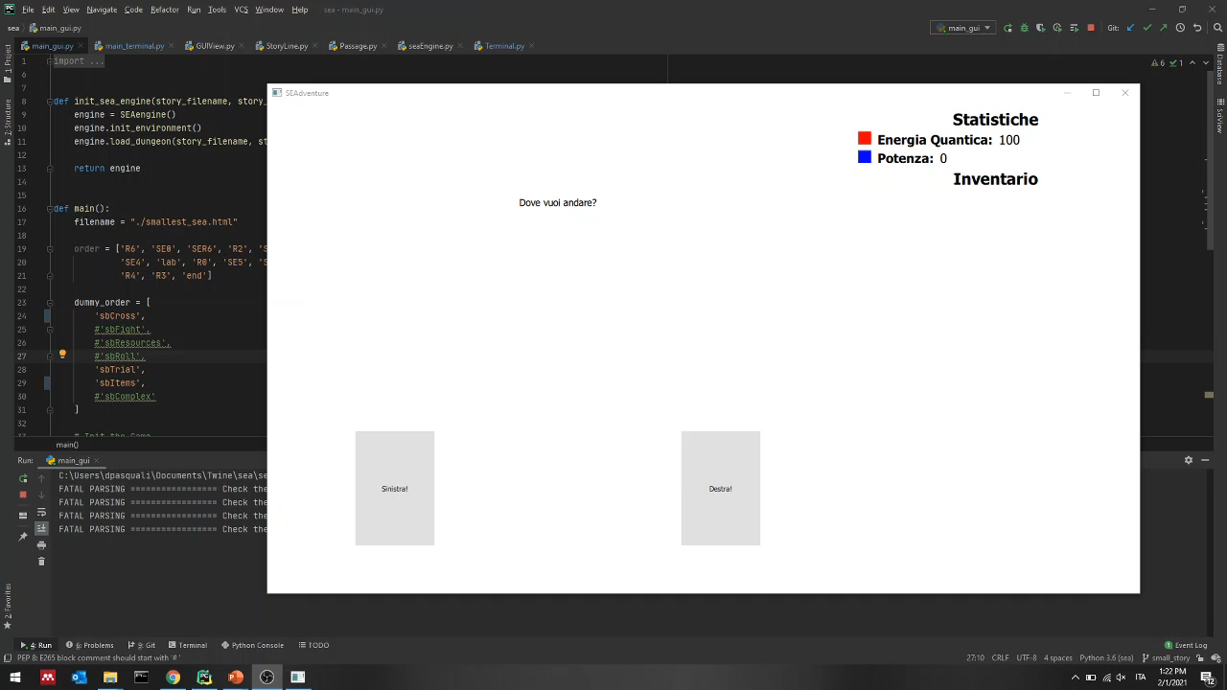
SEA – Architecture & Development
Dario Pasquali
SEA report – Feb 2021

Slide 39
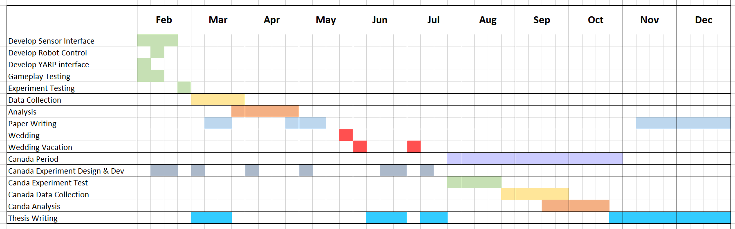
Next Steps
Dario Pasquali
SEA report – Feb 2021

Slide 40
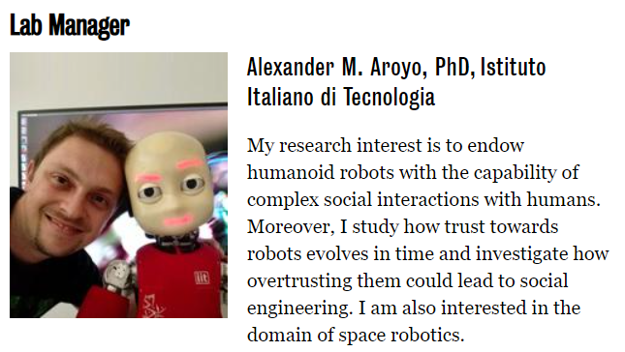
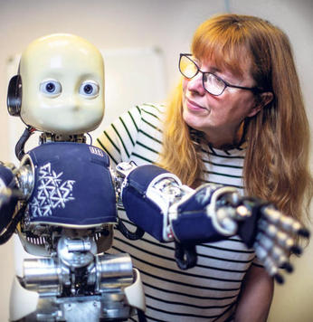

Canada Period
University of Waterloo
25 July -> 30 October
Kerstin
Dautenhahn
- Improve iCub Social interaction & Persuasion
- Architecture to integrate multiple physiological sensors and HRI
Dario Pasquali
SEA report – Feb 2021

Slide 41
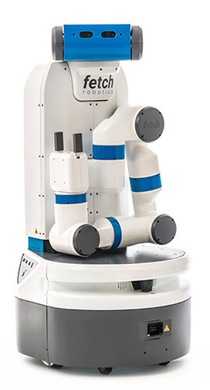
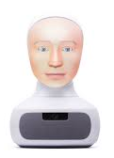
Canada Period – Topics
Explore different robot roles iCub as a social robot companion. It detects you are going to fall in a Social Engineering trap and persuade you to not fall
14 trial from SEA without iCub
Social Engineering playground (to develop)
Explore different robots Do the same game, but with a different robot (i.e., fetch or furhat)
Virtual vs Physically present
Other ideas / requirements ?
Dario Pasquali
SEA report – Feb 2021

Slide 42
Canada Period – Topics
Explore different robot roles iCub as a social robot companion. It detects you are going to fall in a Social Engineering trap and persuade you to not fall
14 trial from SEA without iCub
Social Engineering playground (to develop)
Move toward a “desktop setup” with the perception from a pc webcam
- Desktop Mount eyetracker (EyeLink 1000)
- Webcam and facial features extraction (Logitech Brio 4k + OpenFace)
Dario Pasquali
SEA report – Feb 2021

